Slide 1

Angular 2
By B Supporter Co., Ltd.

Slide 2
Angular?
Url: https://angular.io
One framework Mobile & desktop.
Develop Across All Platforms
Speed & Performance
Incredible Tooling
Loved by Millions

Slide 3
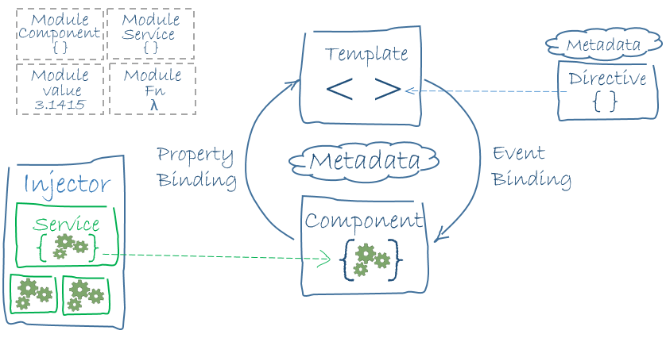
Architecture

Slide 4
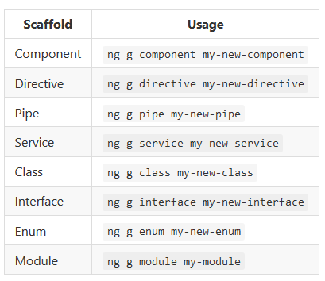
Angular-CLI
Prototype of a CLI for Angular 2 applications based on the ember-cli project.
Url: https://cli.angular.io/
Installation
npm install -g angular-cli
Usage
ng --help

Slide 5
Component & Module
Component?
Module?
Create project from angular-cli
File Structure
Bootstrap
Create Home page
View Encapsulation
Shared
Barrels
import

Slide 6



Component
Menu
Content 1
Content 2

Slide 7

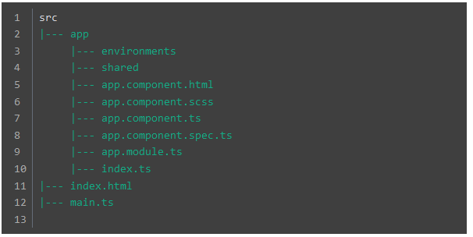
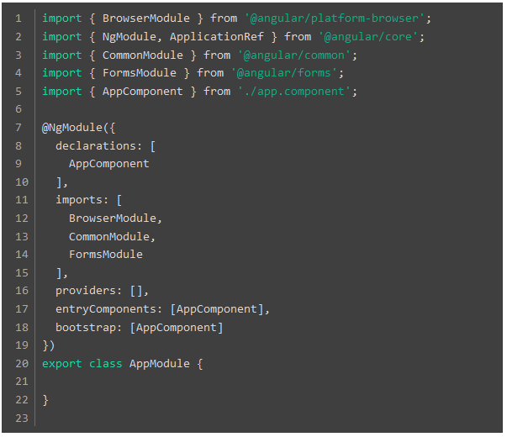
File Structure
app.module.ts

Slide 8
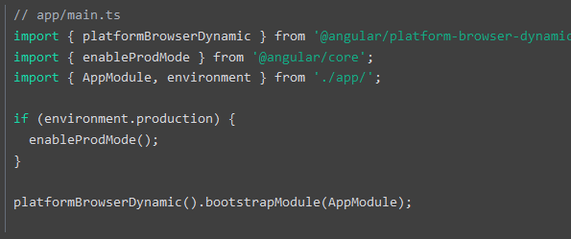
Bootstrap

Slide 9
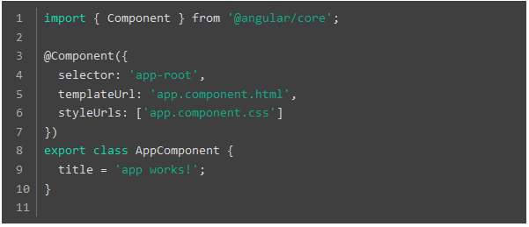
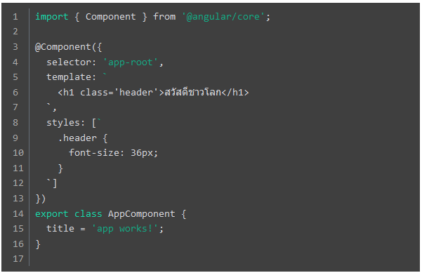
Create Home page
src/app/app.component.ts
selector
templateUrl
styleUrls

Slide 10

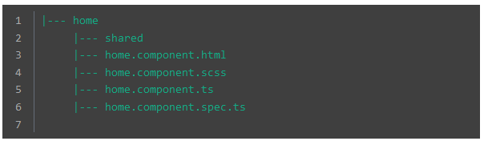

Create Home page

Slide 11
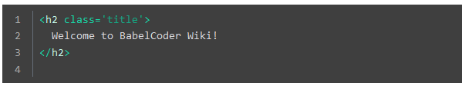
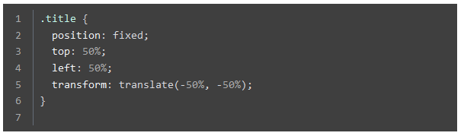

View Encapsulation
Native
Emulated
Url:https://angular.io/docs/ts/latest/guide/component-styles.html#!#inspect-generated-css
None

Slide 12

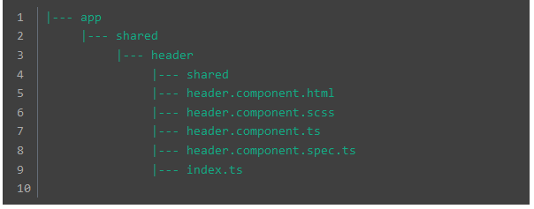

Shared

Slide 13
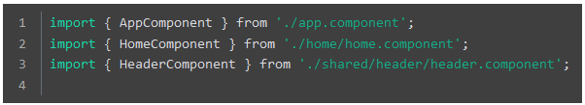
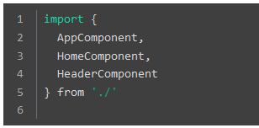
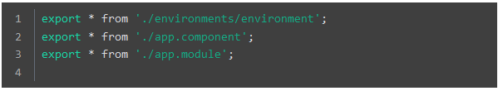

Barrels
app/index.ts

Slide 14
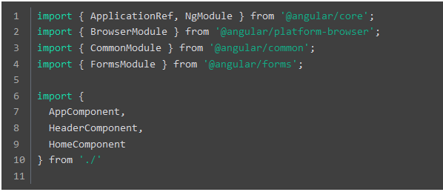


Import Instruction

Slide 15
Routing & Service
Routing Manage
app.routing.ts
Router Outlet?
Page routing manage
Router Links
Structural Directives
Service ?

